Slide 1


Mobility Sensing
Road Anomaly (Pothole) Detection with Smartphone Sensors
Ang Khee Hwa Randi (A0198526N)
9 May 2020
Mobility Sensing

Slide 2
Background
01
02
03
04
High smartphone penetration rates, combined with the advent of cheap and ever more powerful suite of microprocessors and sensors on smartphones, presents a new frontier of Internet of Things (IoT) applications previously not possible. LTA’s Mobility Sensing Project (MSP) seeks to ride on this wave and explore the use of various IoT smartphone applications to meet the objectives of the Land Transport Master Plan (LTMP) 2040 through more personalised analytics and new ground sensing applications.
IMPROVE TRAVEL EXPERIENCE
OPTIMISE PLANNING
Provide insights on travel patterns, manage service disruptions
For first-mile-last-mile journeys where existing data is limited
20-MINUTE TOWNS, 45-MINUTE CITY
BROADEN SCOPE OF HITS
Journey time diagnostics, know where people transfer
Continuous and comprehensive understanding of commuting behaviour to support qualitative surveys

Slide 3
Project Outline and Goals
Under the MSP umbrella, Road Anomaly Detection (RAD) represents a Proof Of Concept (POC) research to demonstrate the viability of the use of smartphone sensor data to detect potholes through a combination of signal processing, machine learning and crowdsensing techniques in the Singapore context. The ability to detect potholes and patch potholes early, will result be better commuter safety and lower economic cost at the system level. Using the above-mentioned techniques, a moderate accuracy of 74-86% was achieved.
More Potholes Detected
Better Road Safety & Comfort
More Timely Road Repairs
Lower Detection & Road Repair Cost
Lower Risk of Vehicle Damage
Notes:
More Potholes Detected
Wider net cast with the use of passive crowdsensing techniques
Not limited by the frequency of road inspections by road surveyors and number of roads surveyed
Currently, LTA’s MyTransport.SG app allows commuters to report road defects whenever the encounter one, but it requires users to actively report them – which most users are too lazy to do so or is simply inconvenient (when they are driving)
More Timely Road Repairs
Repairs can be triggered earlier once potholes have been found
Lower Detection & Road repair cost
Physical road surveys by road surveyors engaged by LTA is extremely time consuming and prone to human error, as it is done by manual physical observation (labour cost)
Existing high precision road surveying equipment using LIDAR can be very expensive and done less frequently
Early repairs can prevent road anomalies from degrading further reducing the repair cost
Better road safety & comfort
Potholes can result in traffic accidents especially if vehicles are travelling at high speeds
Uneven roads due to potholes can lead to uneven rides
Lower risk of vehicle damage
Larger potholes may cause tire flats or damage the vehicle chassis

Slide 4





Road Anomaly Classifier
Anomaly Classes
Sensors
Accelerometer
3-Axis Linear Acceleration (m/s²)
Gyroscope
X-Axis Gyroscope Rotation (rad/s) | Rotation Vector
Magnetometer
Rotation Vector
Pothole
Null
GPS
Location Coordinates | GPS Accuracy
Note(s):
Null cases includes any vibration noise cause by jerky driving, engine noise, and other mundane road surface artefacts e.g. humps, drain covers, cracking etc.
Notes:
Linear acceleration excludes the effect of gravity
These sensors were chosen as they are ubiquitous to all modern smartphones and are generally low powered, with the exception of GPS.
Also, a market study of the SG smartphone market indicated a prevalence of flagship phone models by smartphone sales and usage, which all have those sensors.
It should also be noted that security restrictions on iOS platform may limit the full utilisation of those sensors and their derived variables, which is important for subsequent app development and the target customer base.

Slide 5
Workflow Overview

Slide 6

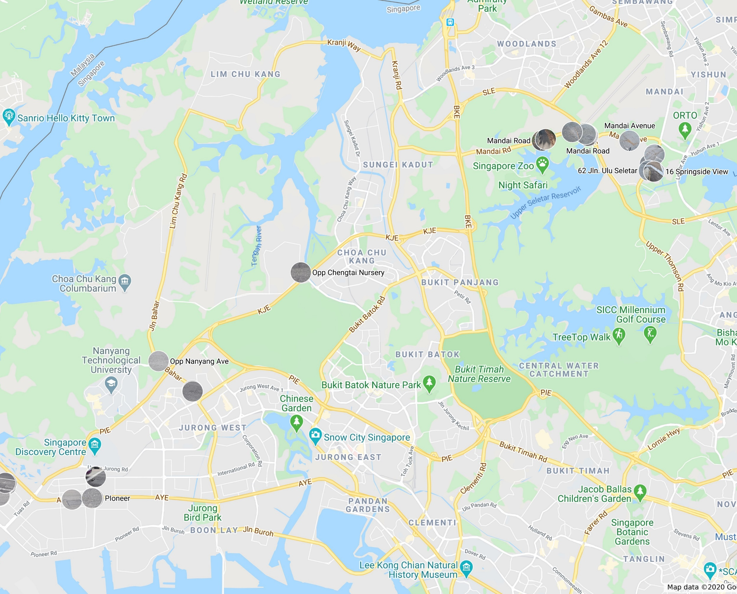


Data Collection
Smartphone
Samsung Galaxy S7 (Android 8)
Samsung Galaxy S20+ (Android 10)
Ground of Truth Points Surveyed
Min. 3 passes of each zone
Sensor Logger App
AndroSensor (v1.9.6.3)
Sampling Frequency: 20Hz
Vehicle
Hybrid Bicycle (with Front Suspension)
Phones mounted on the bicycle frame
Note(s):
Ideally a motorized vehicle should be used, but difficulty in requisitioning a vehicle resulted in a bicycle being used instead
Notes:
For max stability, the mount should be as rigid as possible, mounted directly to the chassis close to the center of gravity for best results
Various apps in-house and external apps were experimented on, but AndroSensor was the most reliable and easy to use at the point the experiments were conducted
20Hz was chosen as the initial test indicated that it was the fastest stable sampling frequency by the app whilst satisfying the Nyquist Frequency requirements.
Bicycles travel much slower than motorised vehicles (past experiments typically used 100Hz sampling frequency as the baseline), making it possible to use a slower sampling frequency.
These areas were chosen to be surveyed the to the presence of heavy vehicles travelling in those areas, subjecting to roads to more wear and tear.
Mandai PCN was chosen was as its asphalt paving was analogous to road conditions, was badly paved and damaged resulting in a lot of potholes, and safety due to the lack of motorised traffic
Lower Seletar Reservoir PCN was also chosen due to its asphalt paving was analogous to road conditions and safety due to the lack of motorised traffic

Slide 7
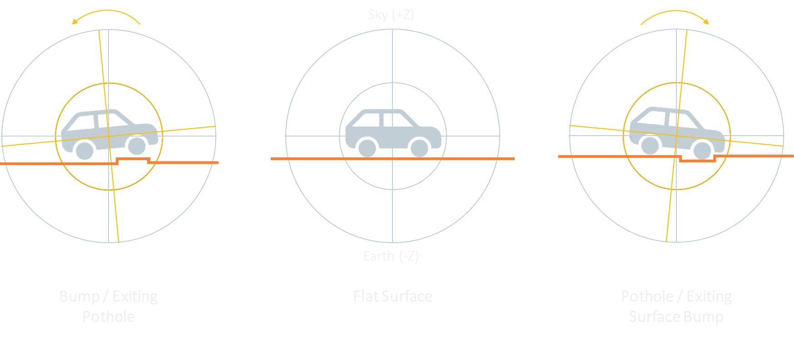
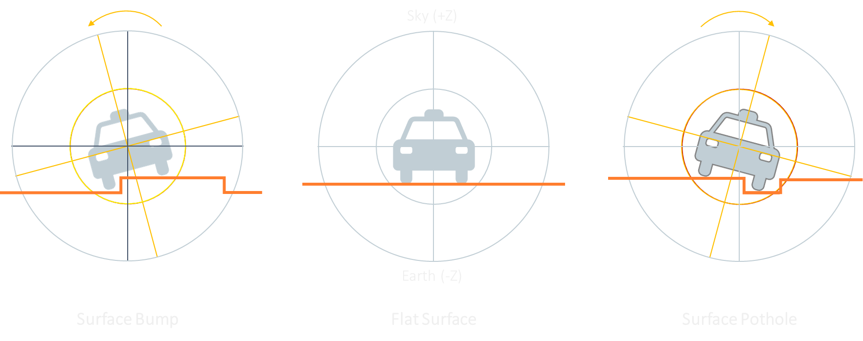
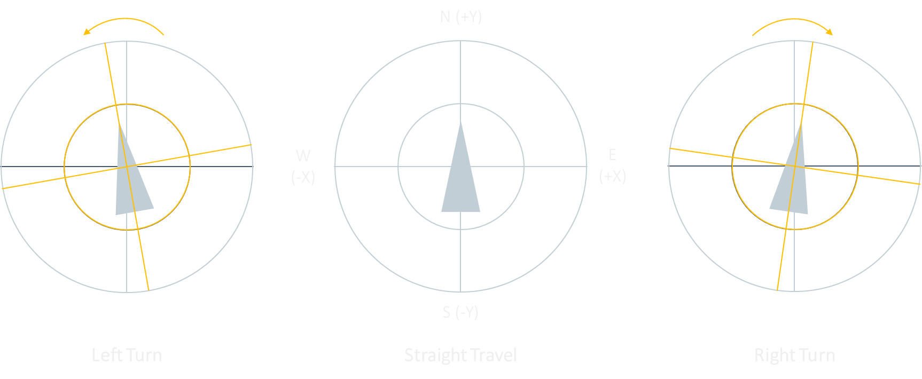
Collating Data and Reorienting Values
Event Distribution
Object Motion During Pothole Encounter
Tagging & Cleaning of Sample Data
Phone Orientation (World Coordinates)
Y-Axis (+ve / North)
Rotation: Pitch
Bobbing Action on Z-Axis
Z-Axis (+ve / Sky)
Rotation: Yaw / Azimuth
X-Axis (-ve / West)
Rotation: Roll
X-Axis (+ve / East)
Rotation: Roll
Event Types (340,105 observations):
0: Stationary
1: Potholes
2: Speed stripes
3: Normal cycling
4: Road humps
9: Uneven terrain & noise
Z-Axis (-ve / Earth)
Rotation: Yaw / Azimuth
Y-Axis (-ve / South)
Rotation: Pitch
Notes:
Some cleaning of the data is performed to clip off the junk portion.
Each recording is then tagged at various portions to give a rough indication of the event being recorded at each instant.
This is quite imprecise, limiting it’s use for supervised learning methods.
The signals are then stitched together by zone, sorted by the road artefact found at each zone for easy comparison later.
Linear acceleration and gyroscope data needs to be aligned to world coordinates for cross comparison of recordings when the phone is placed in different orientations.
It also allows one to isolate key signals from specific axes.
In this case, we are focusing on:
Horizontal linear acceleration: past studies indicated that a pothole event will cause a momentary dip in linear acceleration on 3 axes due to jerk caused, akin to the deceleration event caused by hitting a bump
Z-Axis linear acceleration: pothole encounters would cause a bobbing action captured by the Z-Axis
X-Axis Gyroscope Rotation: pitch rotation would be observed when a vehicle encounters a pothole, caused by the rocking action
Y-Axis Gyroscope Rotation: NA for single track vehicles; balancing and turning action of single-track vehicles can introduce noise to the data
Z-Axis Gyroscope Rotation: No relation to bump encounter

Slide 8
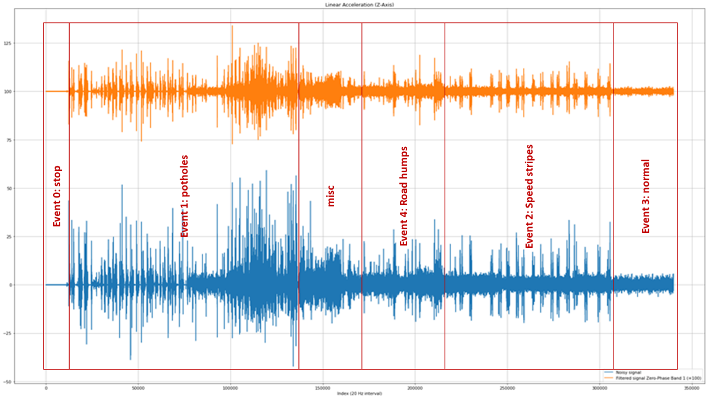

Signal Filtering & Feature Engineering
Bandpass Filter Sample
Z-Axis Linear Acceleration | Filtered Data in Orange & Unfiltered Data in Blue
Sliding Window Descriptive Stats
Window Size: 30 | Shift: 1
SN | Descriptive Stats Generated
1 | Signal magnitude
2 | Moving Average (absolute values used for comparison)
3 | Moving Median (absolute values used for comparison)
4 | Moving 5th Percentile
5 | Moving 95th Percentile
6 | Moving Range
7 | Moving Percentile Range (95th Percentile to 5th Percentile)
8 | Moving Standard Deviation (SD)
9 | Moving Inter Quartile Range (IQR)
10 | Deviation from 2 SD from Moving Average
11 | Deviation from Moving Median + 1.5 * Moving IQR
12 | Deviation from 95th Percentile
13 | Deviation from fixed cut-off point (absolute values used for comparison) Horizontal Linear Acceleration cut-off point: 10 m/s² Filtered Linear Acceleration (Z-Axis) cut-off point: 7 m/s² Filtered Gyroscope Rotation (X-Axis) cut-off point: 0.2 rad/s
Horizontal Linear Acceleration
$$Horizontal Linear Acceleration =\sqrt{{{LA}_{x−Axis}}^{2}+ {{LA}_{y−Axis}}^{2}}$$
Premise:
Higher magnitude, central tendency value, range and more positive deviation from extreme upper cut-off points → Pothole
Notes:
Fourier transform who applied to help identify key frequencies between the tagged pothole data and the tagged non-pothole data
A 6th Order Butterworth (Zero-Phase) bandpass filter was then used to extract the key signal data
Horizontal Linear Acceleration was used to capture the dip changes in acceleration in a directionless manner (since vehicles may turn in any direction)

Slide 9
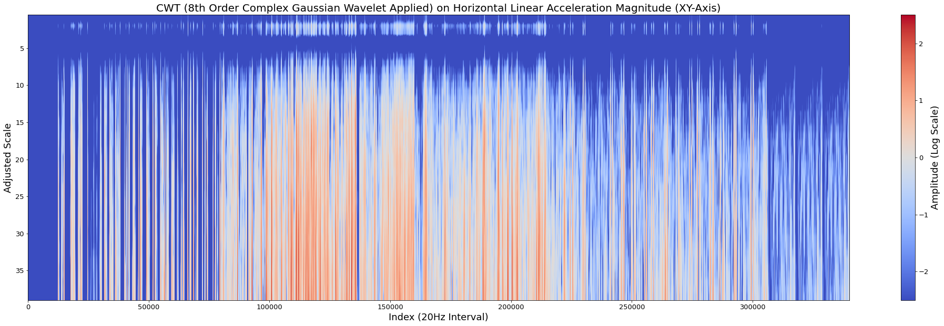
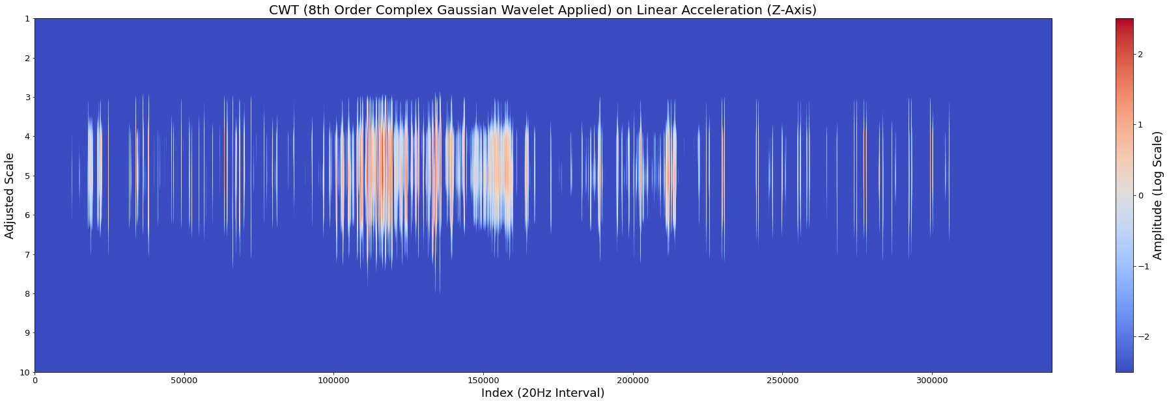
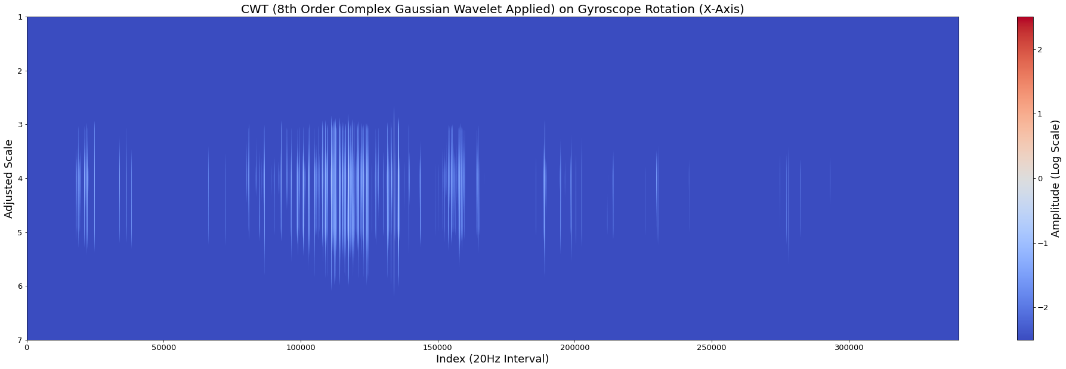
Continuous Wavelet Transform (CWT)
CWT Coefficients
HLA | Z-Axis LA (Filtered) | X-Axis Gyroscope Rotation (Filtered)
Scalogram Interpretation:
The higher the scale (Y-Axis), the slower the change
The X-Axis denotes the time which the event occurred
Colour bar indicates energy level (high: red; low)
Target Scales: 1-10
Contains coefficients with higher energy indicative of potholes
Captures fast moving changes of a pothole encounter
Additional Feature Engineering For Each Scale Extracted:
Deviation from 95th percentile
Deviation from Upper Outlier Fence
Notes:
The natural log of the coefficient magnitude was used to make the differences more apparent.
Additional thresholding was used to suppress weaker values to make the differences starker too.
Values from higher scales (esp for HLA) has been excluded even though they registered high amplitudes, as they represent slower moving changes.
This could be due to inertial forces at work on objects mounted to the bike, resulting in rattling. This is highly subjective and also captured a significant amount of normal cycling data which should be excluded.
Higher positive deviation from extreme upper cut-off points → Pothole

Slide 10
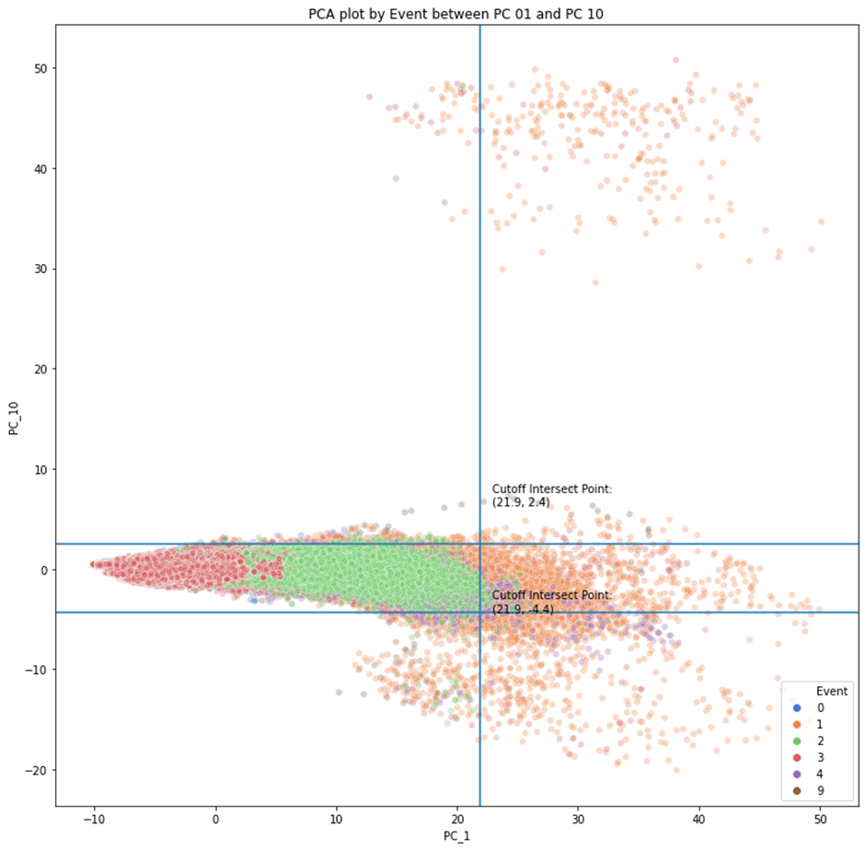
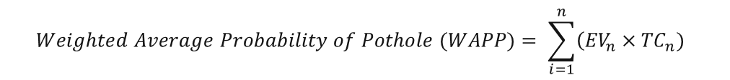
Modelling
PCA
Principal Component Analysis (PCA) was used to perform variable reduction, resulting in 26 Principal Components (PC)
A portion pre-tagged pothole observations (Event 1 / Orange) were noted to have more extreme values compared to other events in the PC Plots, especially for PC 1-10. Possible indication of potholes.
Weighted Average Probability of Pothole (WAPP)
EV = Explained Variance of PC_{n}
n = PC number
TC = Threshold Condition
Max WAPP Value = 92.394%
$$Weighted Average Probability of Pothole (WAPP)= \sum_{i=1}^{n}{\left({EV}_{n}×{TC}_{n}) \right.}$$
PC | WAPP 1 | WAPP 2
1 – 2 | Top 0.2% most extreme values | Top 1% most extreme values
3 – 26 | Top 0.1% and bottom 0.1% most extreme values | Top 0.5% and bottom 0.5% most extreme values
WAPP Value Cut-Off | WAPP >= 70% | WAPP >= 80%

Slide 11
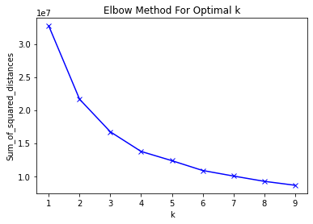
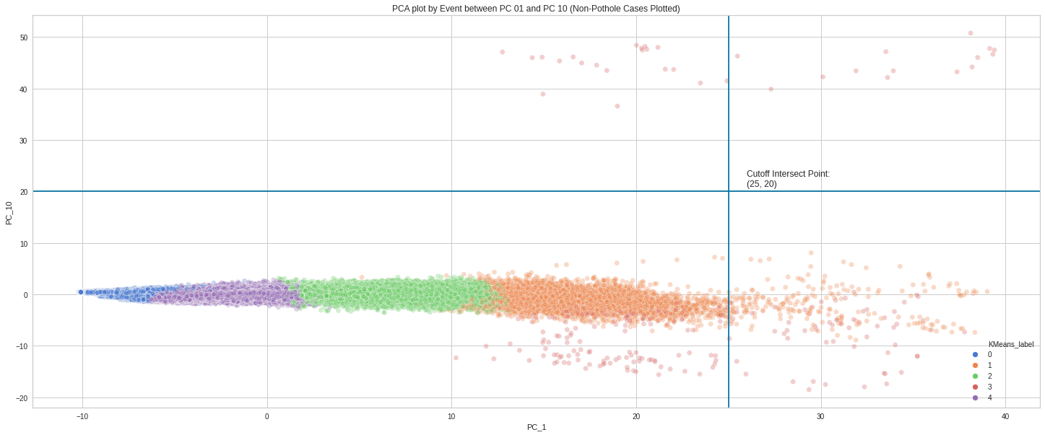
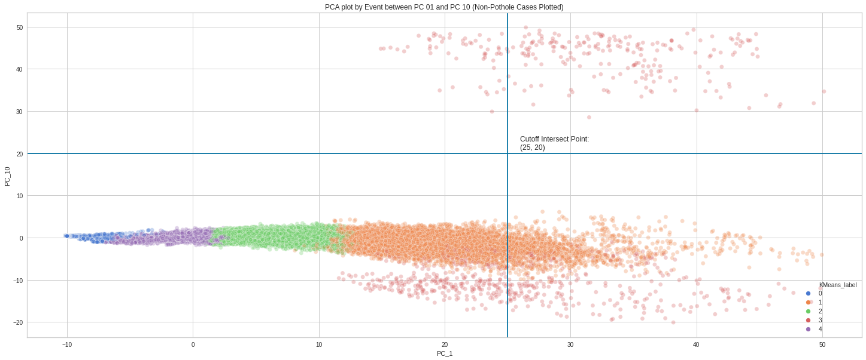
Modelling
K-Means Clustering (K = 5)
Input variables: PC 1-10
Good separation of suspected pothole events (Cluster 3 / red) against non-pothole events when compared to pre-tagged data
Ensemble Voting of WAPP and K-Means Clustering Results to ID Suspected Potholes
Alpha (w/o HDBSCAN): 2 or more votes (622 observations; 0.183%)
Beta (w/o HDBSCAN : 3 votes (298 observations; 0.088%)
Geospatial Clustering of Suspected Potholes
Hierarchical Density Based Spatial Clustering of Applications with Noise (HDBSCAN) used
Pools results from multiple sources and filter out spurious results
Epsilon pegged to median GPS accuracy (±4m) of suspected potholes observations
Minimum Cluster Size = 5
Distance metric: Haversine
K-Means Clustering Results
Filtered by Pre-Tagged Non-Pothole Events
K-Means Clustering Results
Filtered by Pre-Tagged Pothole Events

Slide 12
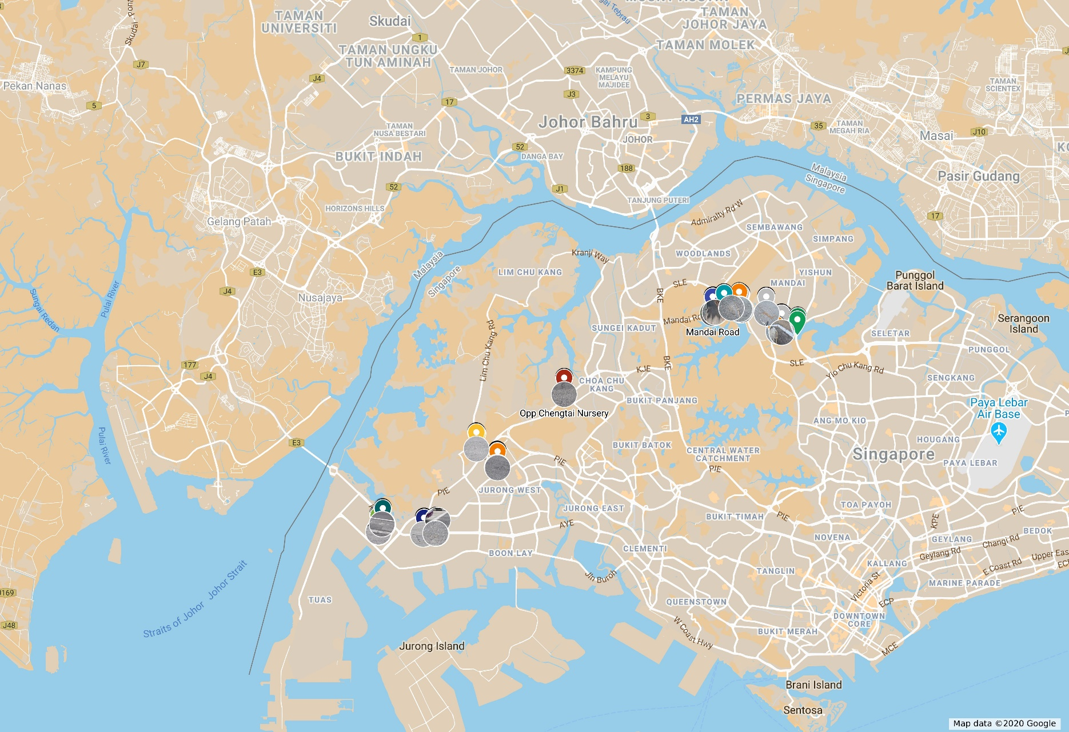
Model Evaluation
Measure | Alpha w/o HDBSCAN | Alpha | Beta w/o HDBSCAN | Beta
Count | 622 | 589 | 298 | 267
% of Suspected Potholes Near Tagged Ground of Truth (GOT) Potholes (33 Points)
% of Suspected Points on Target (±15m) | 77.01% | 76.74% | 80.201% | 84.27%
% of Suspected Points on Target (±10m) | 65.434% | 65.195% | 69.463% | 74.906%
Ground of Truth Zones (Inclusive of Null Cases) Correctly Predicted (22 Zones)
Pothole Detection Accuracy | 72.73% | 72.73% | 77.27% | 86.36%
Model evaluation
Both models Alpha and Beta can detect pothole with fair level of accuracy, though Beta the generally the superior model
Metrics used here tend to understate the specificity (true negative rate) of the models
Tuning of the HDBSCAN is required to account for differences in traffic in filtering out spurious results from false negative events.
Limitations
Unsupervised learning methods for pothole detection is unsuitable for real-time applications, especially GPS is only used on a on-demand basis to save power
Vehicle must contact pothole for detection to be possible
More testing needed to account for variation in:
Vehicle
Road
Driver
Sensor
Notes:
Beta has higher overall accuracy, lower sensitivity and higher specificity than alpha
A distance metric of 15m was used since I was unable to directly geotag each potholes on the road due to road safety issues.
COVID-19 CB lockdown also prevent remeasurements from being taken
Some potholes appear as physical clusters due to multiple cracks branching out from the original weak/damage zone on the road, expanding into new potholes
Unsupervised learning methods can be used to refine tagging of variables for training a supervised learning model subsequently.
Common vehicle variables:
Max speed
Engine vibration
Suspension
Tire pressure
Tire size
Presence of unsecured objects on/in the vehicle
Road
Different road artefacts may produce similar signals
Size of potholes
Driver
Sudden turns
Sudden changes in acceleration/deceleration
Speed control
Sensor
Sensor precision
Computing efficiency for high frequency sampling (no missing values / value alignment)
Battery power was high power sensors like GPS – an external power source may be needed

Slide 13





Future Work
Improvements in Data Collection & Processing
Use of Supervised Learning Methods
More Advanced Classification
Image Classifier Techniques
Final App Deployment
Notes:
Improvements in Data Collection & Processing
Increase sampling frequency (for motorised vehicles)
Remote tagging of potholes (2 loggers required) for cleaner tagging of data
Optimising features used for modelling
Testing with various vehicle, driver, sensor and road permutations
Use of Supervised Learning Methods
If sufficient clean data can be obtained directly, supervised learning methods such as Logistic Regression, Tree-Based or Neural Network can provide real-time classification capabilities
More Advanced Classification
Classifying road anomalies by degree of wear and tear (e.g. pothole size) for repair prioritisation
Classifying different kinds of road anomalies beyond potholes
Use of Image Classifier Techniques
Avoids the need for the vehicle making physical contact with the road anomaly for road anomaly detection to work
Expands classifier to other road defects beyond road surfaces e.g. wear and tear or damage to curbs, road dividers and traffic lights etc.
LTA already has a repository of road defect anomalies images from the daily road surveyor reports
Final App Deployment
Upgrade module to LTA’s MyTransport.SG app or a separate stand-alone app

Slide 14
The End
Q&A
Image Credits:
Selected icons by Becris, Ultimatearm, freepik, bqlqn from Flaticons

